Slide 1
Good Morning!
Content inspired by Jarrett Billingsley’s 449 notes

Slide 2
Questions?

Slide 3
Structs (and dealing w/ them)

Slide 4
Structs
Just data grouped together – kinda like a class, but not quite the same
struct Food {
char name[10];
double price;
int stock;
};
Don’t forget about the ‘;’!

Slide 5


Structs
Just data grouped together – kinda like a class, but not quite the same
struct Food {
char name[10];
double price;
int stock;
};
“Tag”
struct Food grapes;

Slide 6
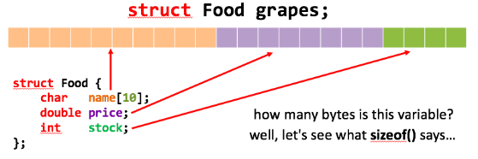
Structs in Memory
struct Food* p = (struct Food*) malloc(struct Food);

Slide 7
Why?
Structs add padding to ensure that the struct is a multiple of the maximum aligned of any field
In this case, sizeof(double) is the highest
Lesson: don’t use pointer arithmetic with structs!

Slide 8
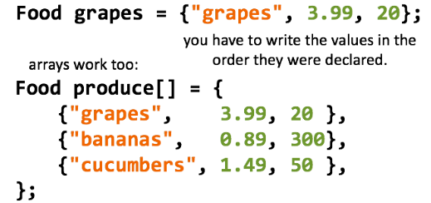
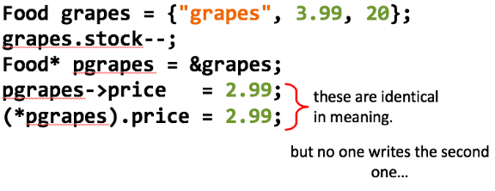
Struct Initialization

Slide 9
Typedef

Slide 10
Making new types
Type def essentially allows you to create a new conveniently-named type from/for other types
Called ‘type aliasing’
typdef int NAME;
NAME x; // same as int x
Useful w/ function pointers

Slide 11
Making new types – structs
We can do the same w/ structs – what you see in the lab
typdef struct Food Food;
Food x; // same as struct Food x
Food* p; // same as struct Food* p

Slide 12
Struct one-line typedef
For structs the following are equivalent:
typdef struct Food Food;
struct Food {
char name[10];
double price;
int stock;
};
typedef struct Food {
char name[10];
double price;
int stock;
} Food;
Don’t forget about the ‘;’!

Slide 13
Garbage Collection

Slide 14
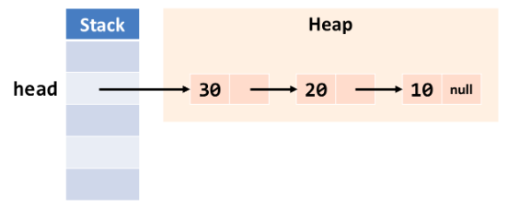
Linked List GC Example

Slide 15
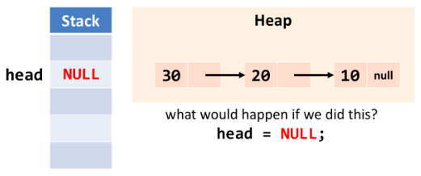
Linked List GC Example

Slide 16
Linked List GC Example
The list goes nowhere!
But our access to the list is gone

Slide 17
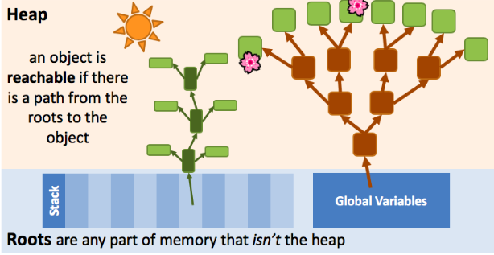
Linked List GC Example

Slide 18
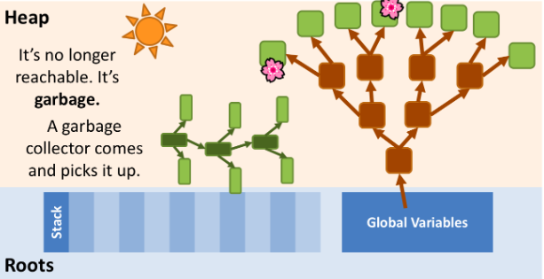
Linked List GC Example

Slide 19
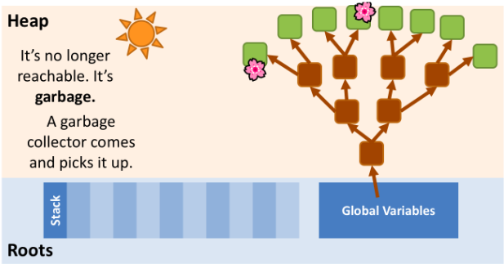
Linked List GC Example

Slide 20
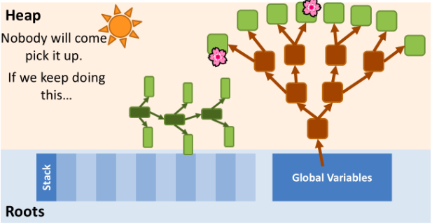
Linked List GC Example

Slide 21
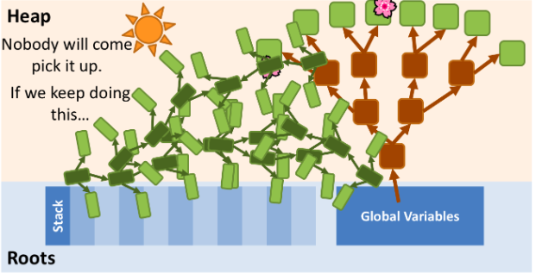
Linked List GC Example

Slide 22
File types (C and H)

Slide 23
Files you might have seen
Enable file extensions on your machine
https://www.itexperience.net/file-extensions-file-explorer/
Some OS already do this, but good ol’ windows doesn’t 😐
There’s some detail behind it but…
.c files is where your code goes
.h files is where the variables and primarily methods go to be seen by other .c files
This is like declaring public variables and methods
All the details handled during linking stage (later in course)

Slide 24
Make

Slide 25
Advanced Linked List
Here

Slide 26
Common Slipups

Slide 27
Common Slipups
Not freeing after error
Understanding when it’s ok not to free something
Null terminator loc/inclusion
Bufsize
Looping in list for free()
Test requirements
(what methods to complete, what to watch out for)

Slide 28
Assembly?

Slide 29
Deadlines
Assignment | Due Date (at 11:59pm)
Lab 3 (Linked List Lab) | Friday, February 26th (tomorrow!)
Homework 2 (C Programming) | Monday, March 1st
https://www.gradescope.com/

